Slide 1
C.A.R.S
Crash Assistance & rescue system

Slide 2


Developed by Team 220 Volts
KANAV BHASIN – kanavbhasin22@gmail.com
DAKSH NAUNI – mr.codefrost@gmail.com
YAKSHIT GUPTA – guptayakshit@gmail.com

Slide 3
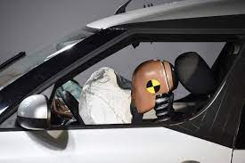
WHAT IS C.A.R.S ??
CARS is software-hardware project developed for Accident Tracking and Assistance of remote user.

Slide 4
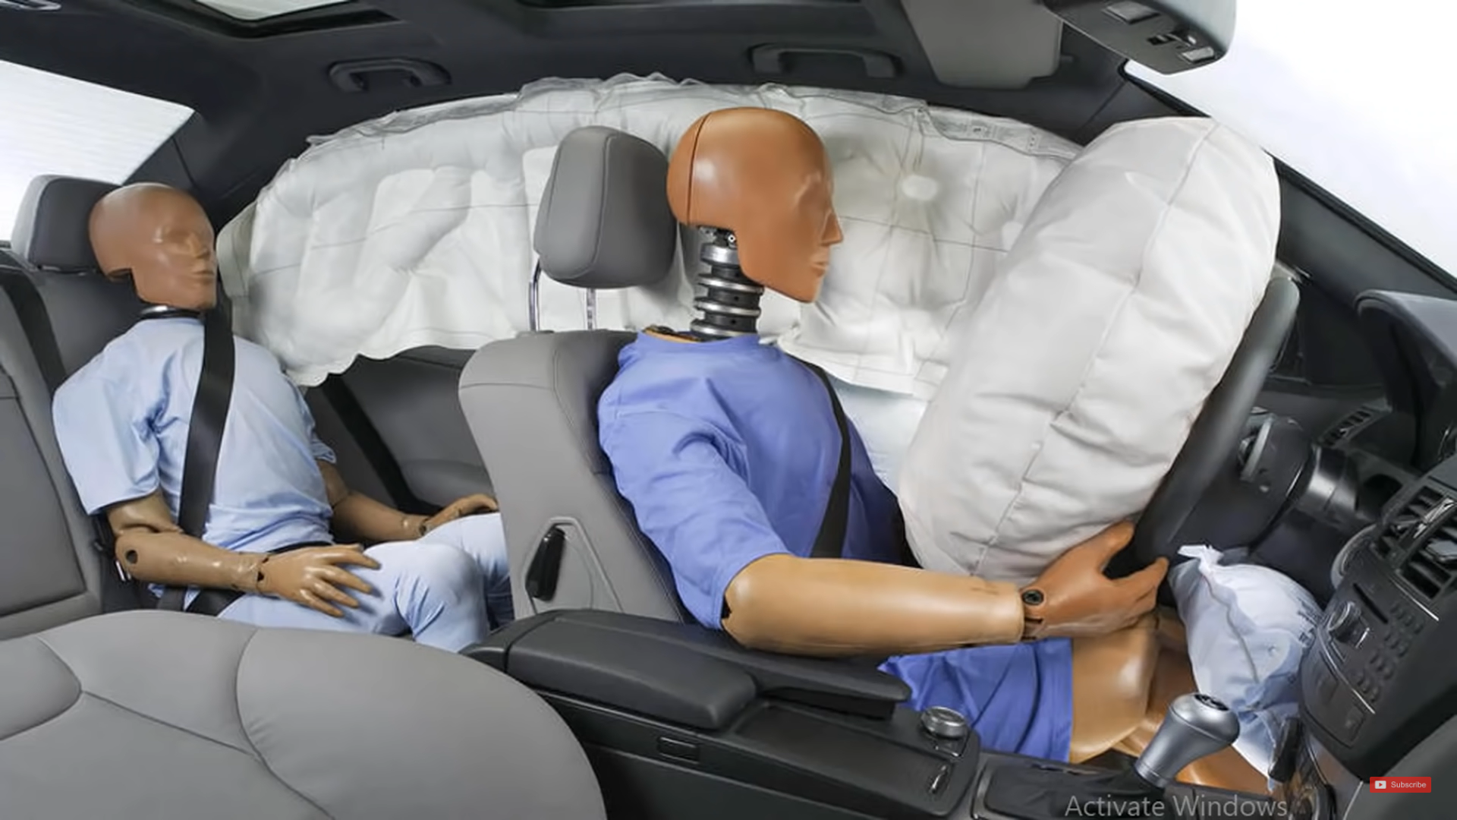
AIRBAG
The purpose of the airbag is that it inflates as soon as the car starts to slow down in an accident and deflates as your head presses against it.
An airbag is also known as a supplementary restraint system (SRS).

Slide 5
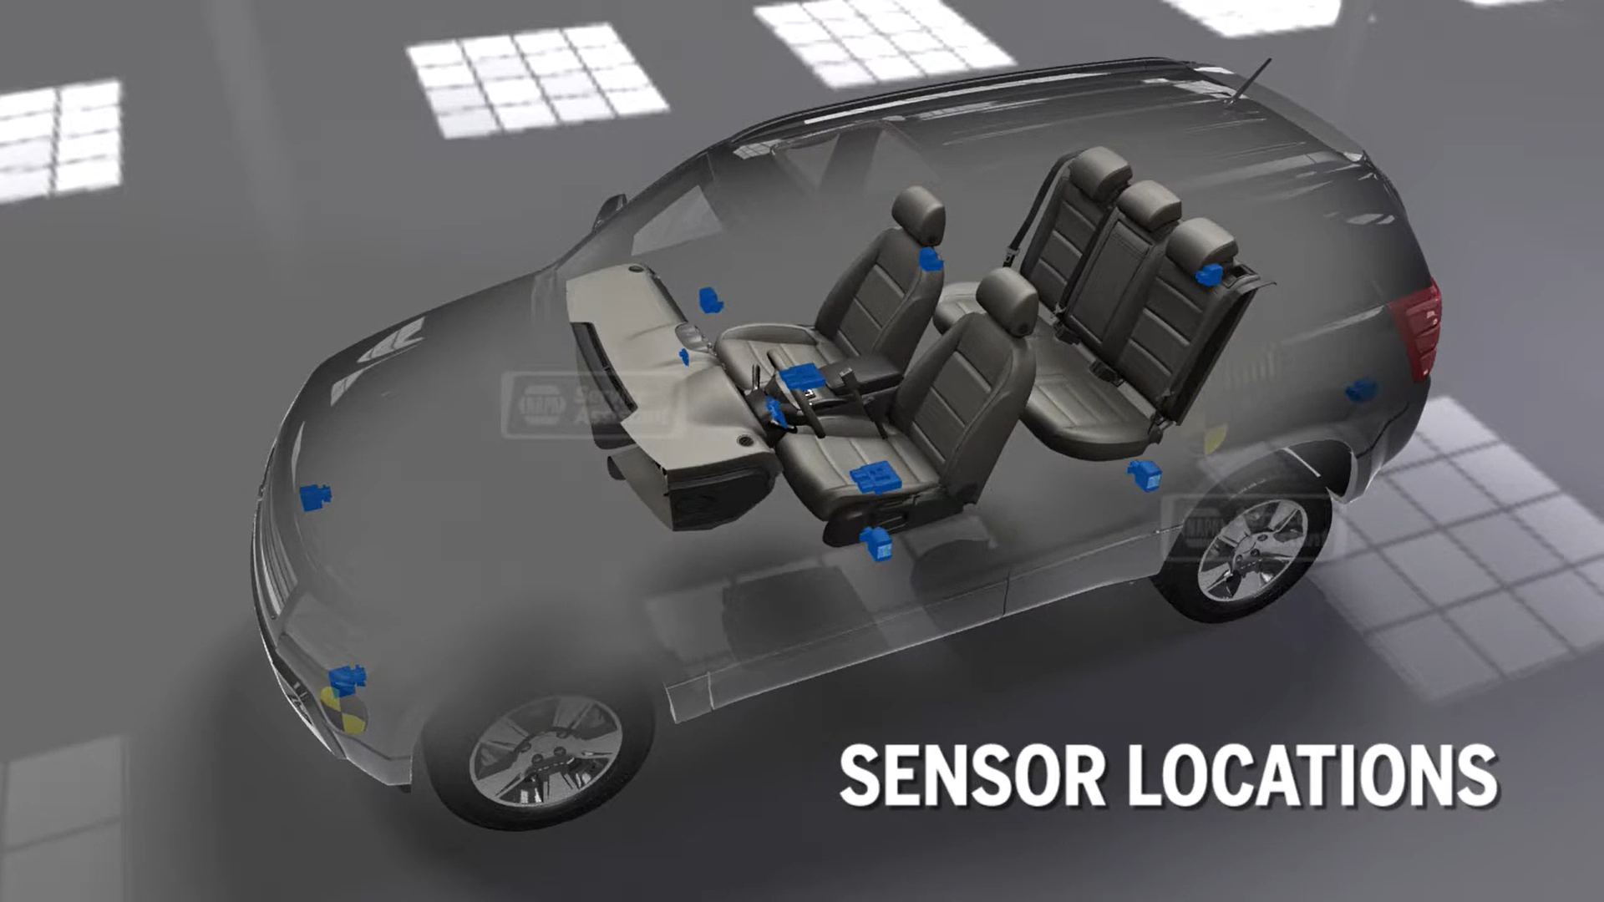
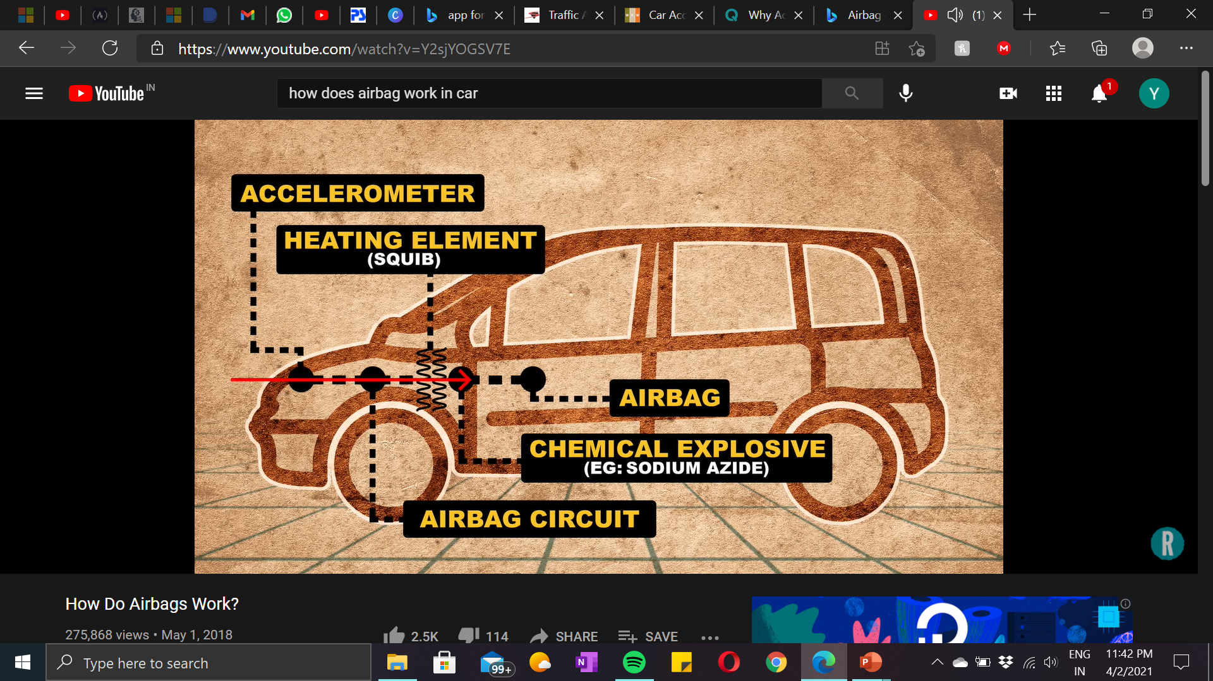
There are impact sensors around the car and if they detect a serious collision, they will tell the airbag to operate. This means a spark lights up, which generates lots of gas, mainly consisting of nitrogen, into the airbag.

Slide 6
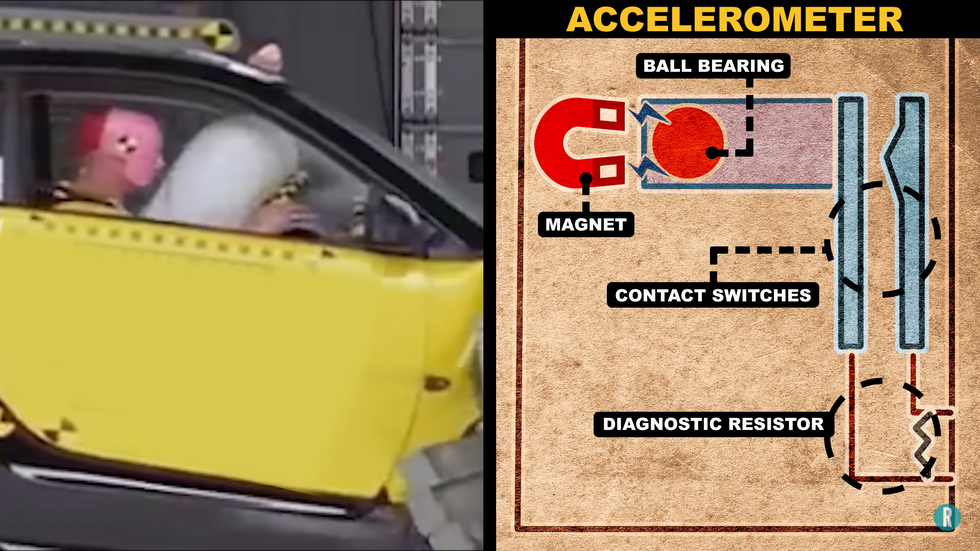
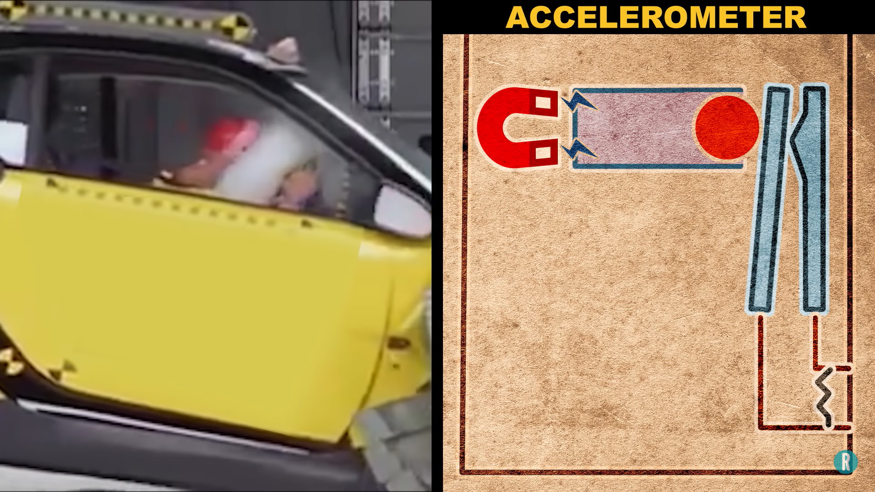
Before Crash
After Crash
Upon collision, the sensor sends a signal to the controller which interprets the electrical input and measures the level of a collision to determine the release of an airbag.

Slide 7
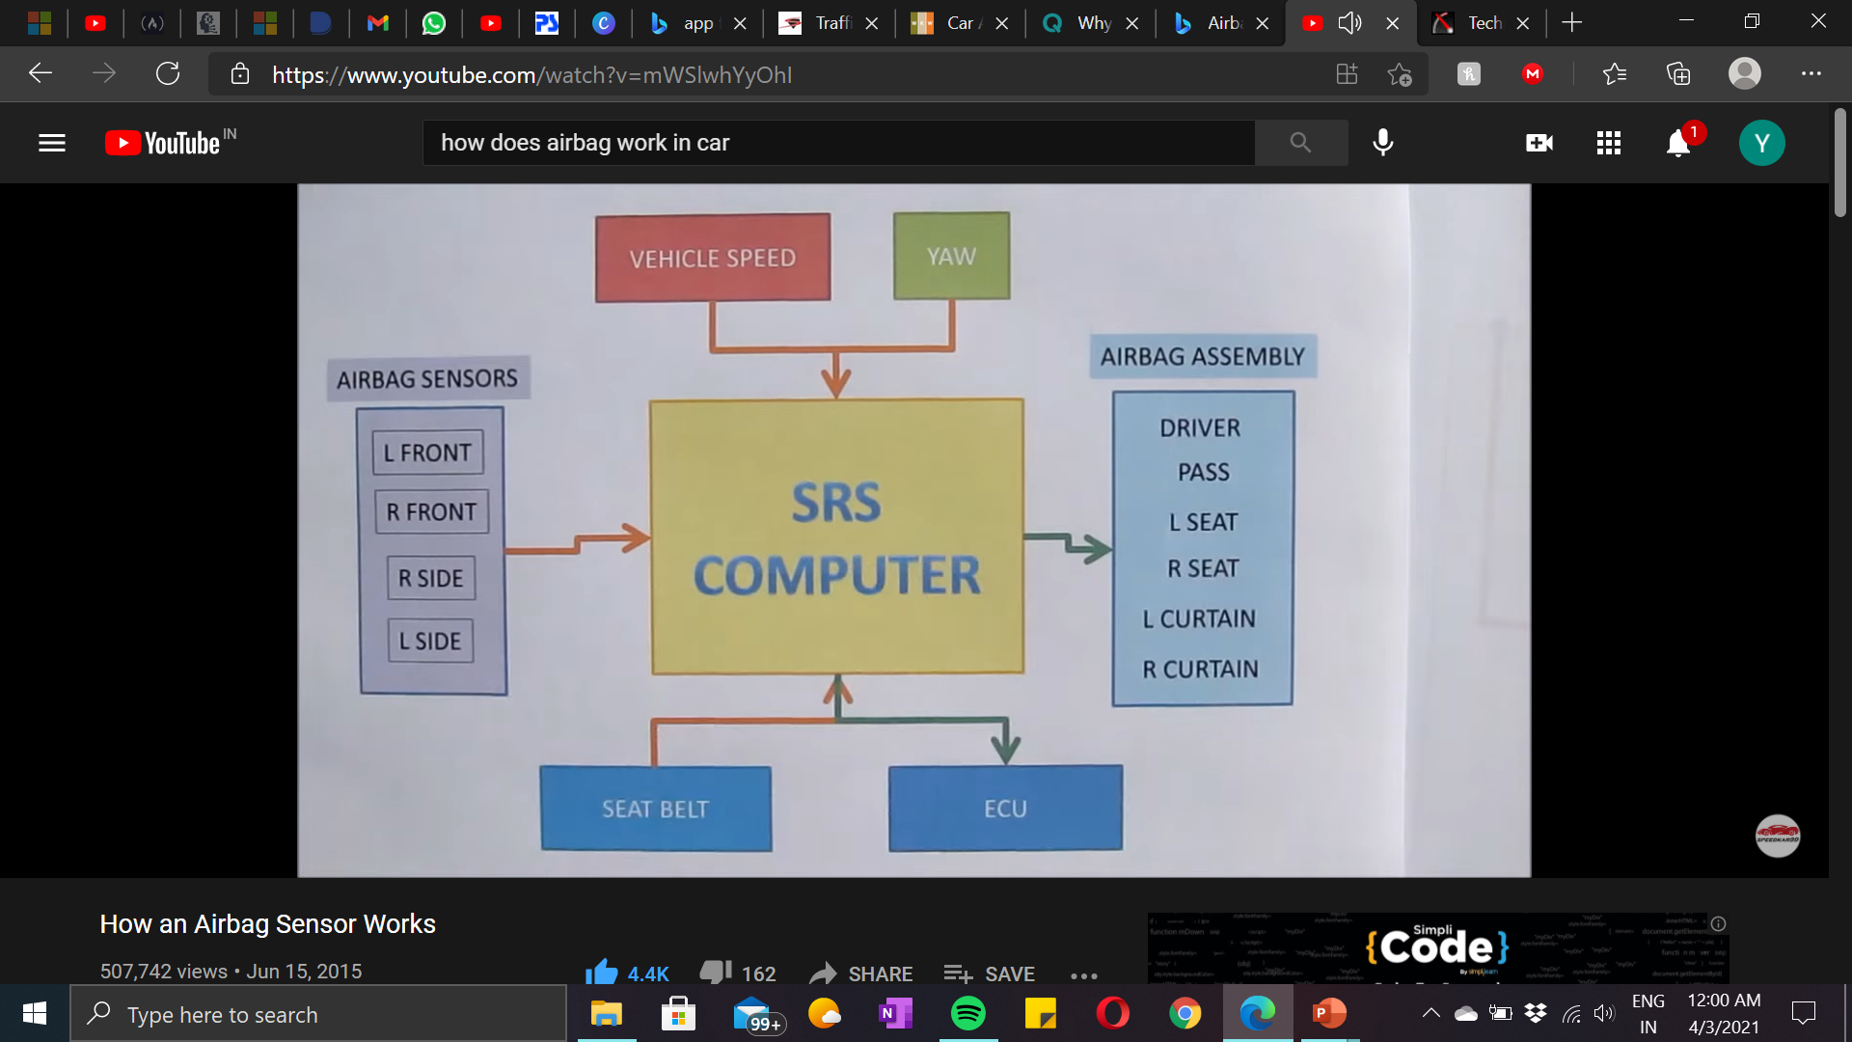
What is also noteworthy about the airbag control module is that it stores crash data and hard codes and the engine logs.
The unit can store the vehicle and engine speed, throttle position, brake light switch position, seat belt use, impact speed change, and airbag and pre-tensioner deployments. This is quite a bit of useful information stored in a module.

Slide 8
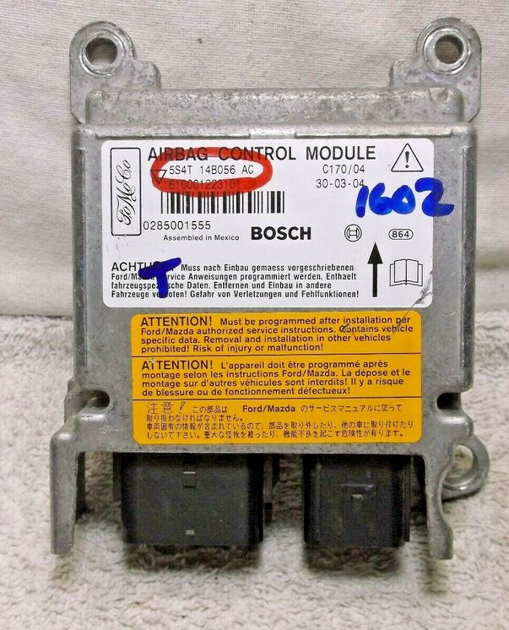
BASE IDEA
The Base Idea behind C.A.R.S is of connecting an additional Moudule with the Airbag Control Module(ACM) which controls the operation of airbags.
As soon as the ACM gets the signal of collision , the additional module using Bluetooth will activate the app in the victim’s mobile and this app will send emergency alert to authorities and family members .
Since we are at initial stage of development, it is unviable to generate a working prototype.
For the time being , we can make model in which victim can manually do this by using the button .On clicking the button , the app will be alerted via Bluetooth and then it will send details forward automatically.

Slide 9
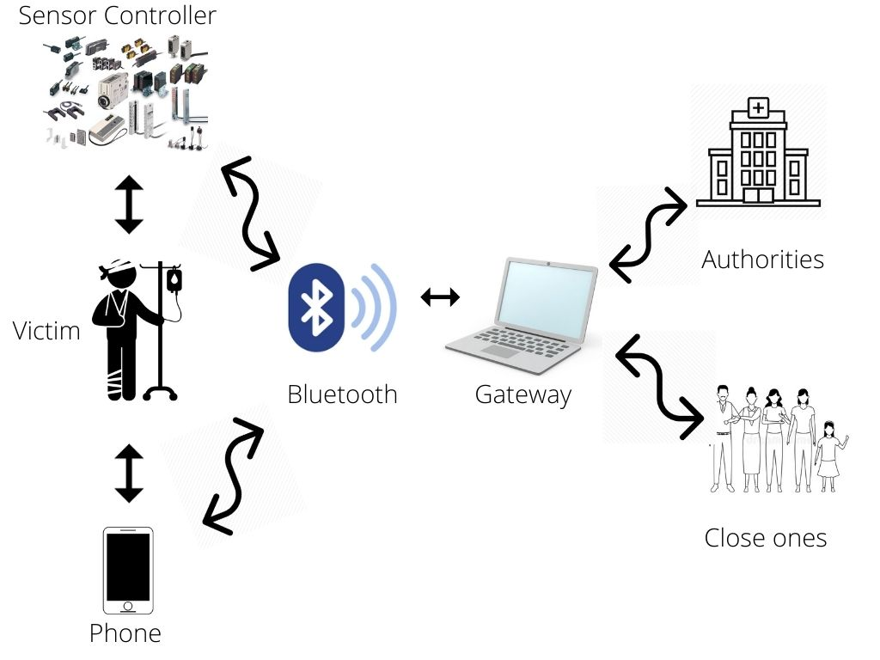
WORKING
C.A.R.S implements sensor technology, internet and flutter application to track accident victims and inform the authorities and other emergency services.

Slide 10
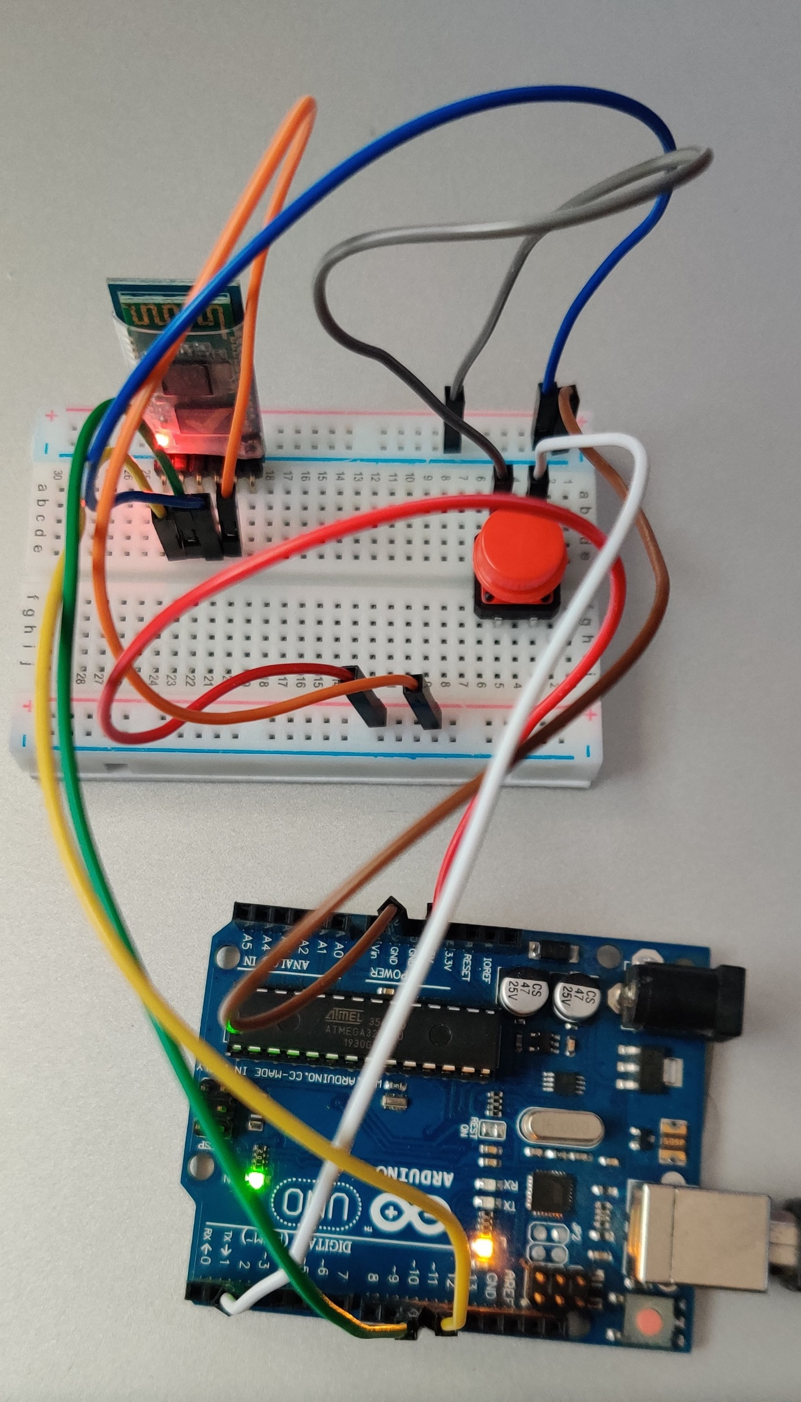
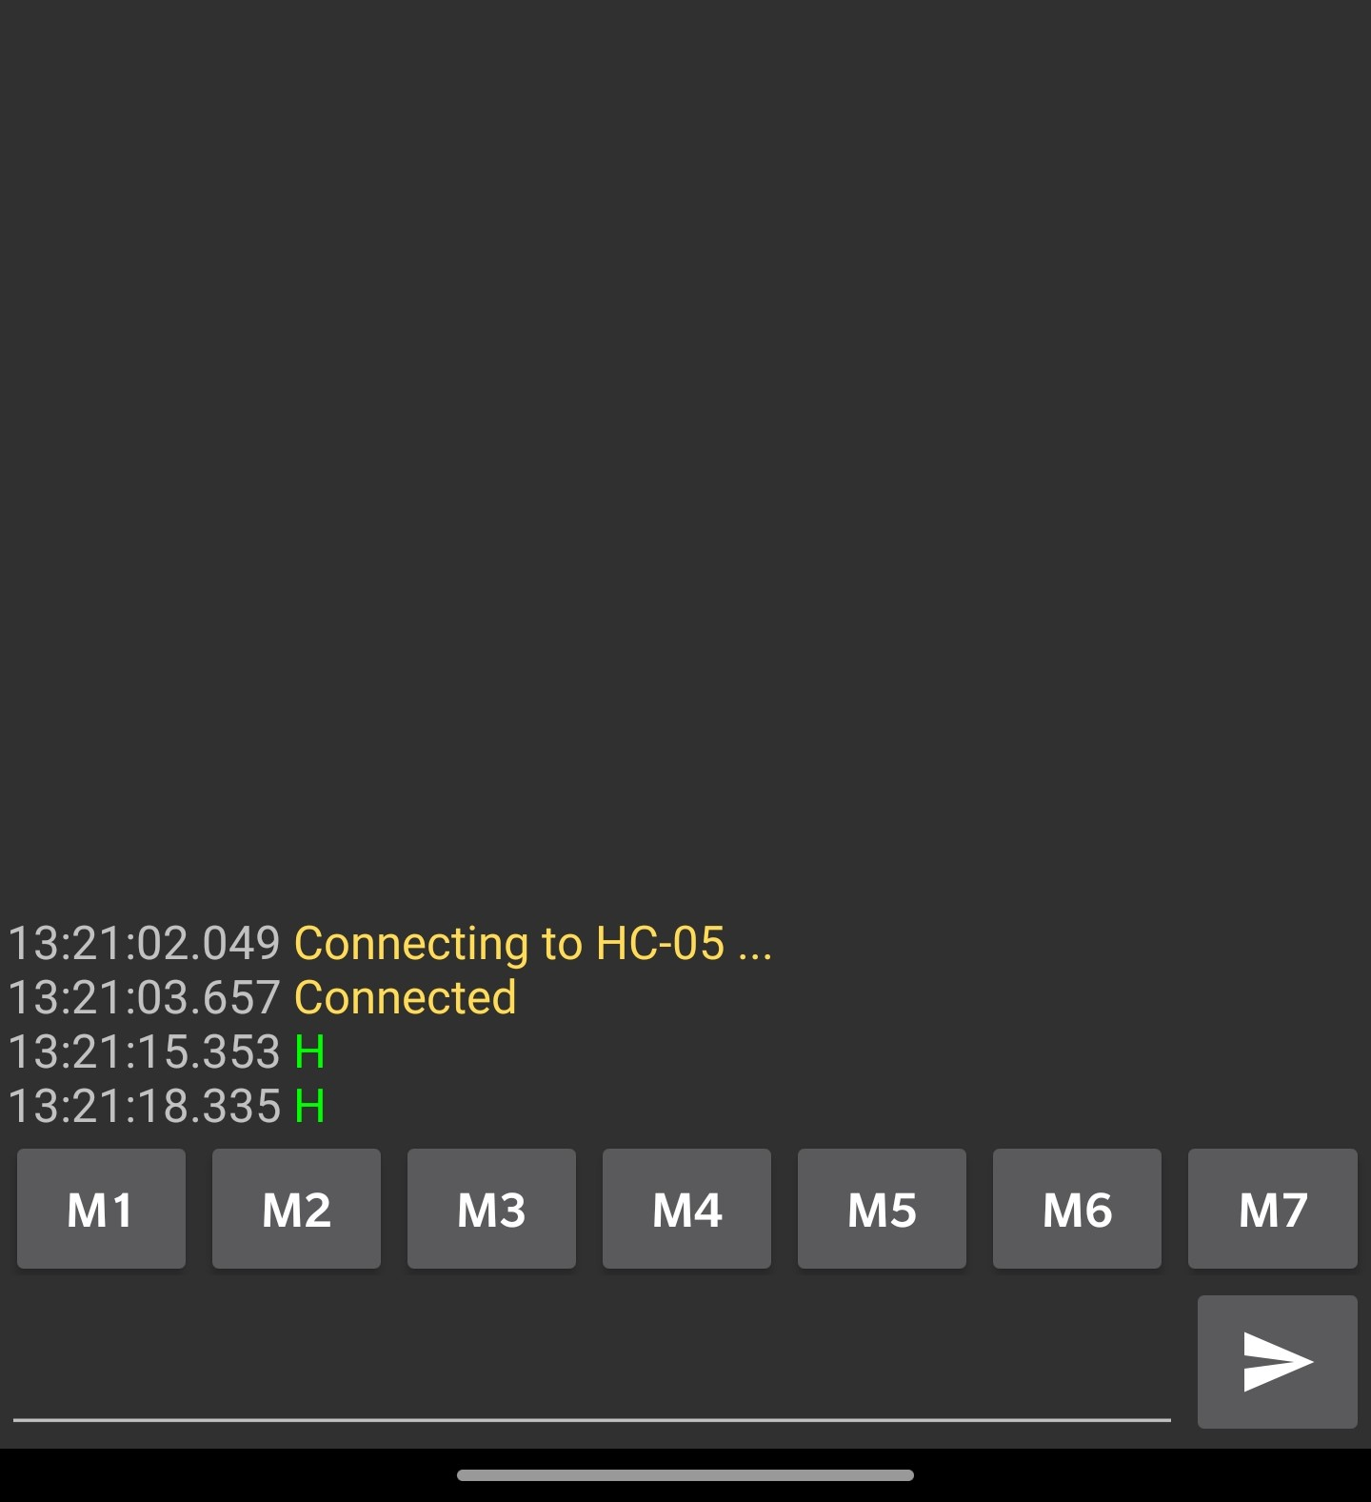
HOW IT WORKS ?
The Hardware (to be connected to the car). This hardware consists of Arduino, Bluetooth module and Push Button. This push button is connected to the IMU of the car and as soon as the car undergoes collision and the airbags are activated, the module sends a notification on the phone and the application is activated

Slide 11
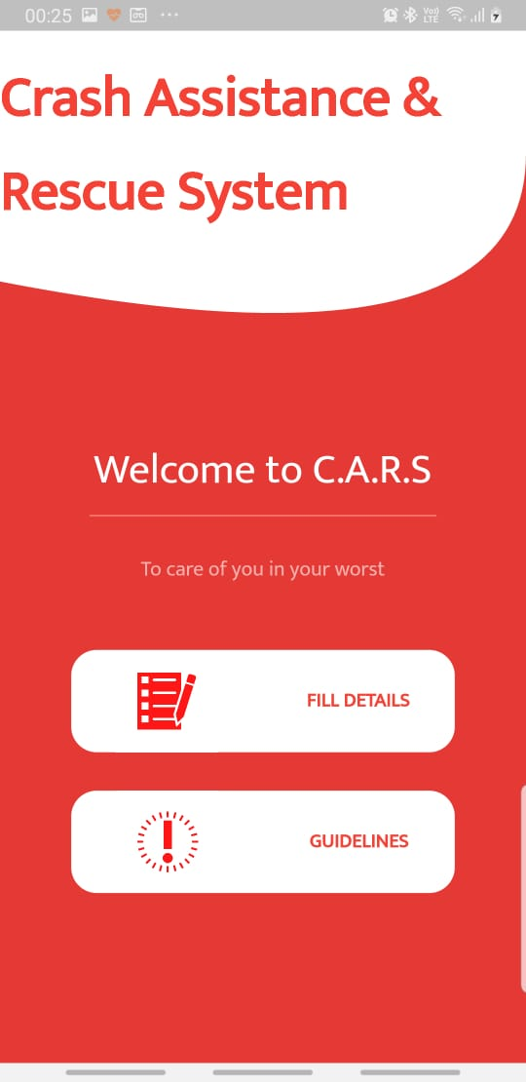
END USER
Software- Flutter App available for all platforms
Developed as a smart portal for accident tracking to assist end-users and integrate with other accident related issues such as helpline no.s , how to give CPR .

Slide 12
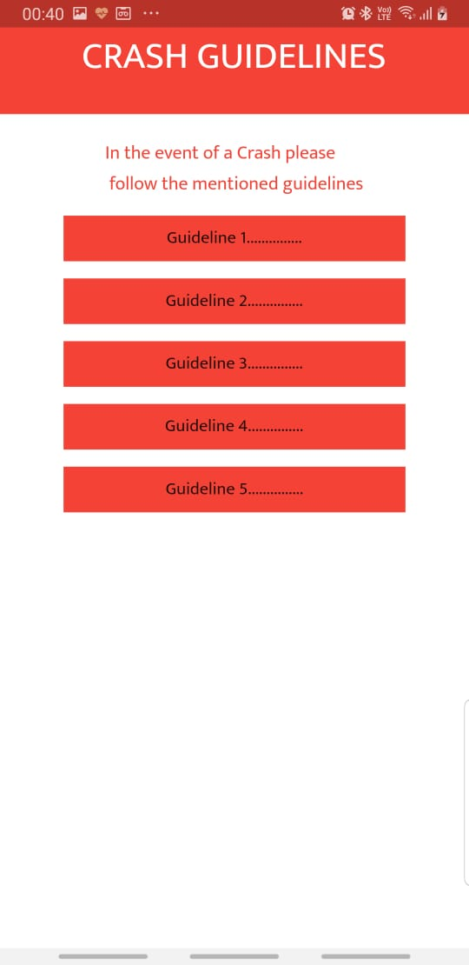
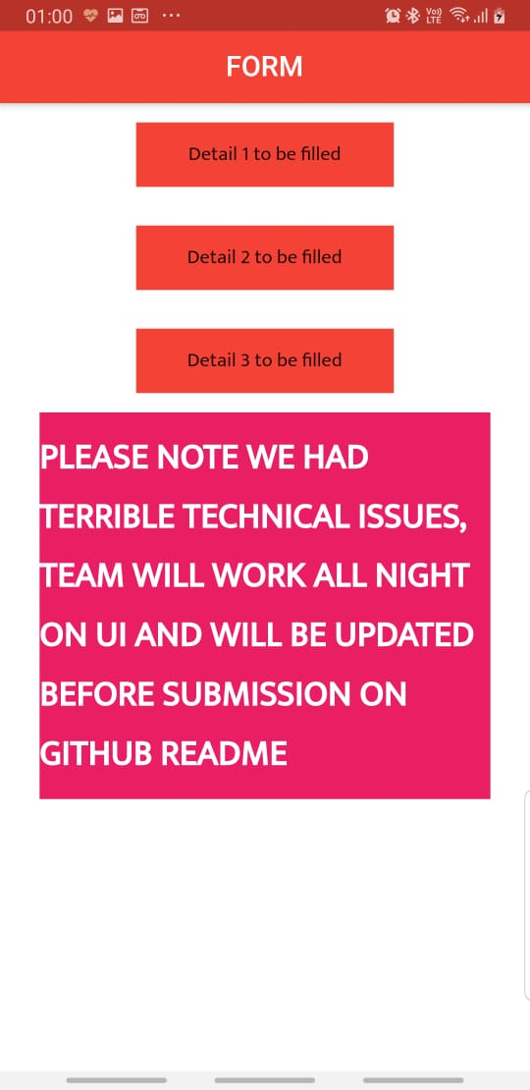
Screenshots of the App

Slide 13





WHY C.A.R.S?
WHY?
Alerts hospitals with personal details such as blood group , any medical history.
Its functionality is quite robust.
Emergency services are immediately dispatched to the site of the accident
Set up alerts for friends and family members to notify them in the event of a collision
Provides emergency safety tips .

Slide 14




Business Idea
Target Audience
Funding
Car Brands as they are constantly looking for features to increase customer safety and experience.
Since we are in the initial stage of development , we will seek for fundings from govt. or may even go private companies.
Fund Category
Feasibility and Usage
Structured funds will be used so as to develop the further prototype..
CARS is an assistance app , created to facilitate the troublesome condition after accident by connecting the victim to authorities and loved ones.

Slide 15
Thank You

